Slide 1

Large Scale Data Processing

Slide 2

Project Overview
In today's data-driven world, the ability to efficiently process and analyze large volumes of data is crucial for businesses to gain insights and make informed decisions
This project aims to leverage the power of Azure Databricks and PySpark to perform large-scale data processing tasks, including Extract, Transform, and Load operations, on massive datasets
By utilizing Databricks clusters, we ensure scalability and parallel processing capabilities

Slide 3

About Project
This project leverages Azure Databricks and PySpark for large-scale data processing on a sample CSV file containing employee data
The dataset consists of approximately 100,000 records with 11 fields including employee ID, full name, job title, department, gender, ethnicity, age, hire date, annual salary, bonus percentage, country, and exit date

Slide 4

Architectural Diagram

Slide 5

Requirements of the projects

Slide 6

Azure Databricks
Azure Databricks provides a cloud-based platform for big data analytics and machine learning​
Databricks provides managed Spark clusters, eliminating the need for infrastructure management and allowing teams to focus on data processing tasks

Slide 7
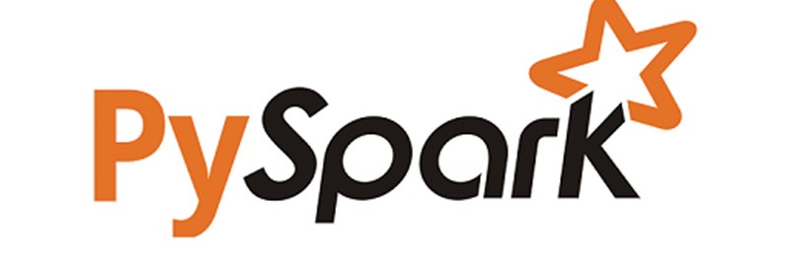
PyspaRK
Azure Databricks provides a cloud-based platform for big data analytics and machine learning​
PySpark is the Python API for Apache Spark, a powerful open-source framework for distributed data processing
PySpark, developers can write concise and expressive code to perform complex data transformations, aggregations, and analytics on large datasets

Slide 8

ETL Operations
Extract:
Data ingestion from various sources such as databases, data lakes, streaming platforms, or external APIs
Transform:
Data transformation tasks including cleansing, filtering, aggregating, joining, and enriching datasets to prepare them for analysis
Load:
Storing processed data into target systems such as data warehouses, data lakes, or serving layers for downstream consumption

Slide 9

Scalability with Databricks Clusters
Databricks clusters dynamically allocate computational resources based on workload requirements, ensuring optimal performance and resource utilization
Autoscaling capabilities automatically adjust cluster size to accommodate changes in workload demand, allowing for seamless scalability without manual intervention
Databricks Runtime optimizes performance with built-in optimizations, caching, and tuning for various workloads, resulting in faster processing times

Slide 10

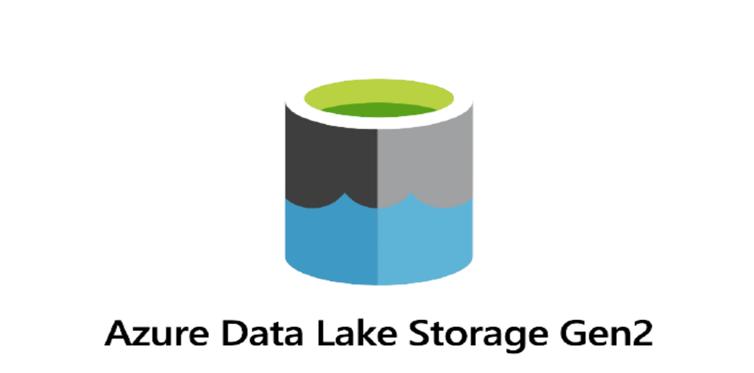
Azure Resources Used for this Project

Slide 11

How It works

Slide 12
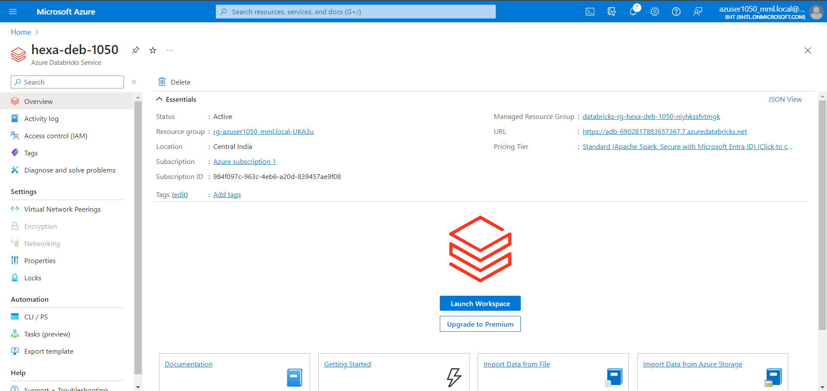
Setting Up Azure Databricks Environment

Slide 13
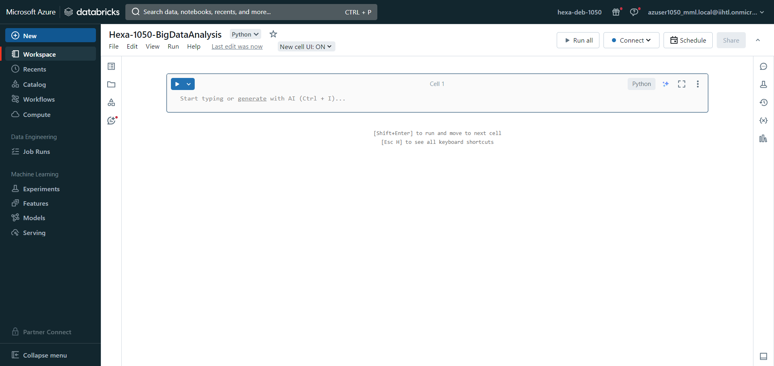
Developing PySpark Notebook

Slide 14
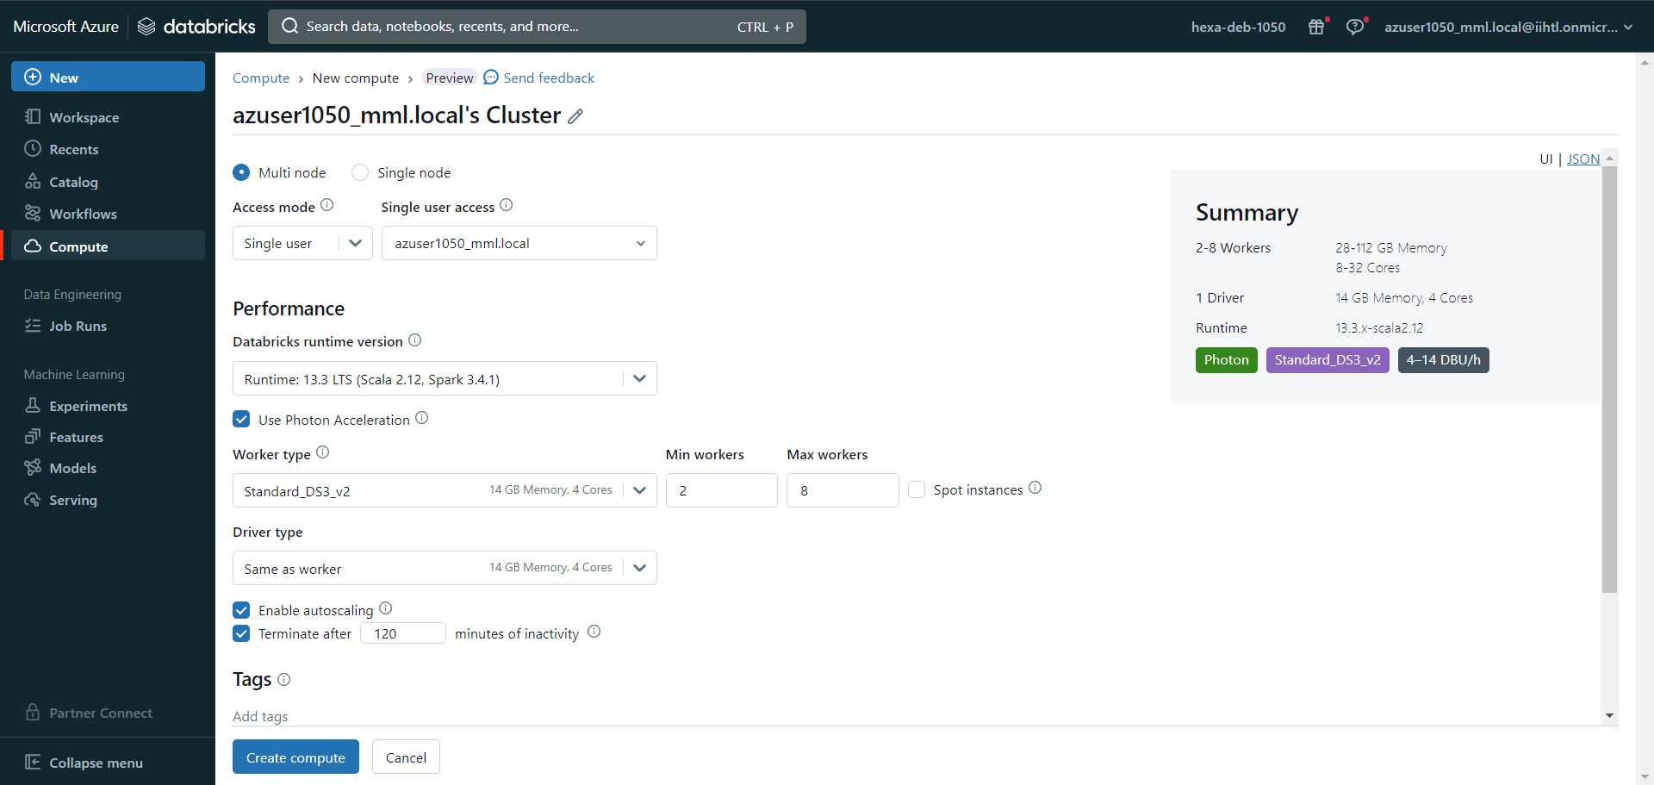
Create Cluster and Connecting to notebook

Slide 15
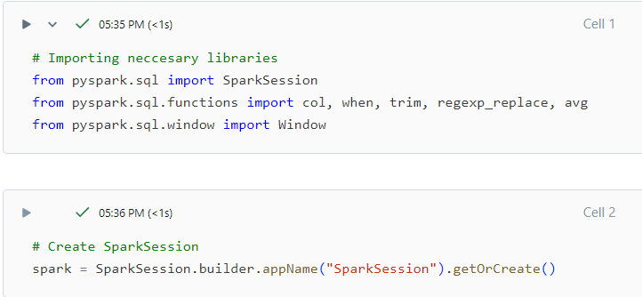
Importing Necessary libraries and Creating Spark Session

Slide 16
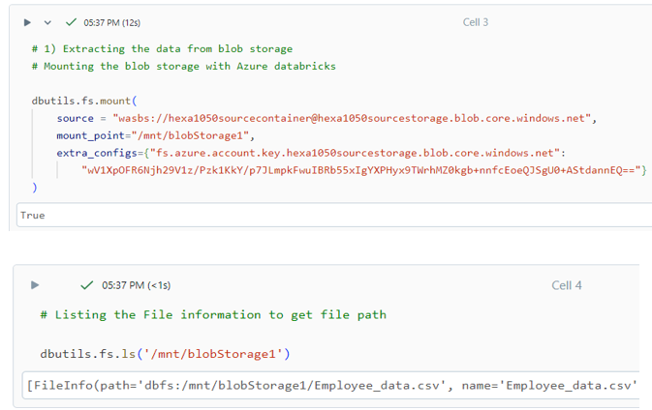
Extracting Data from Source storage

Slide 17
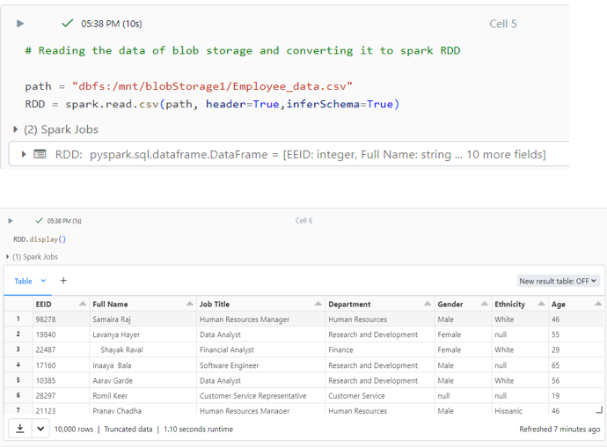

Slide 18
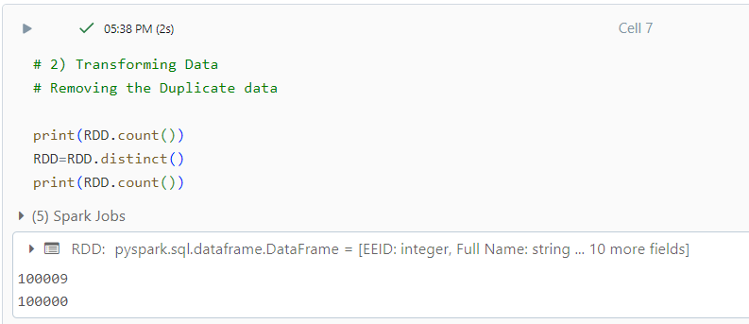
Transforming the raw data
Removing the Duplicate records

Slide 19
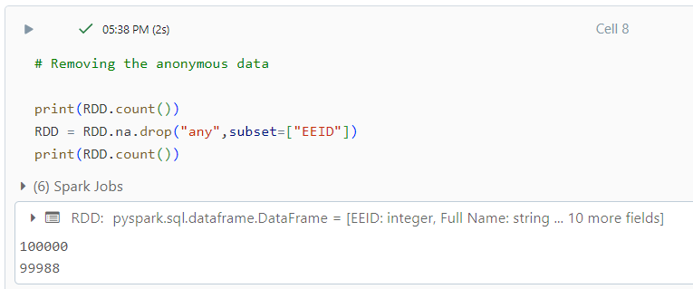
Handling Anonymous data

Slide 20
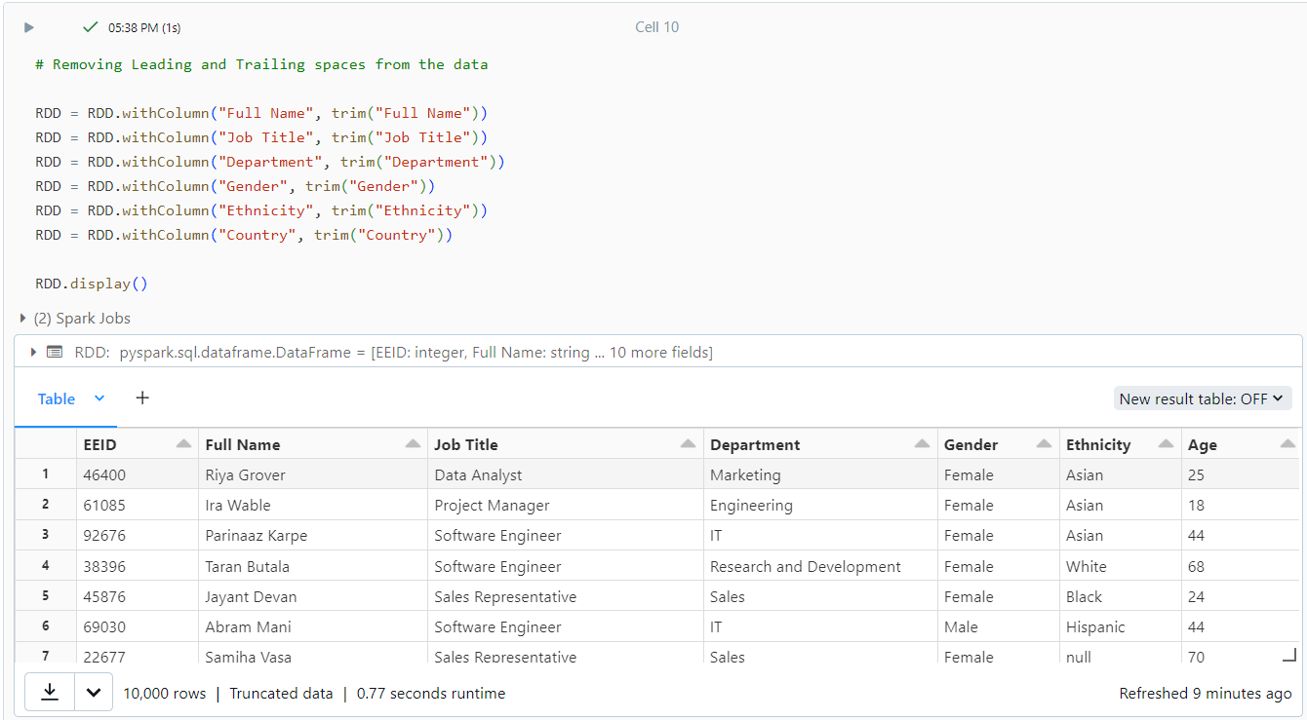
Removing Extra spaces form the data

Slide 21
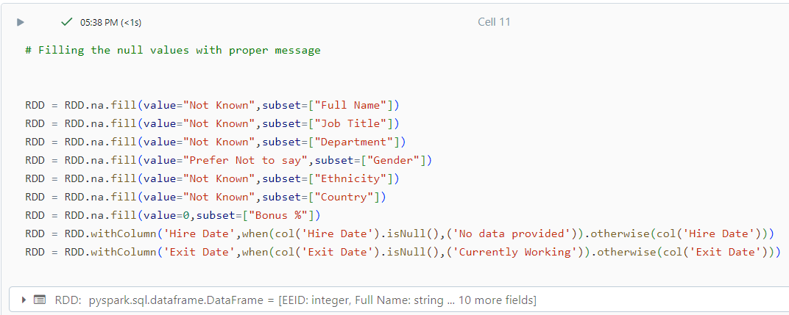
Filling null values with proper messages and data

Slide 22
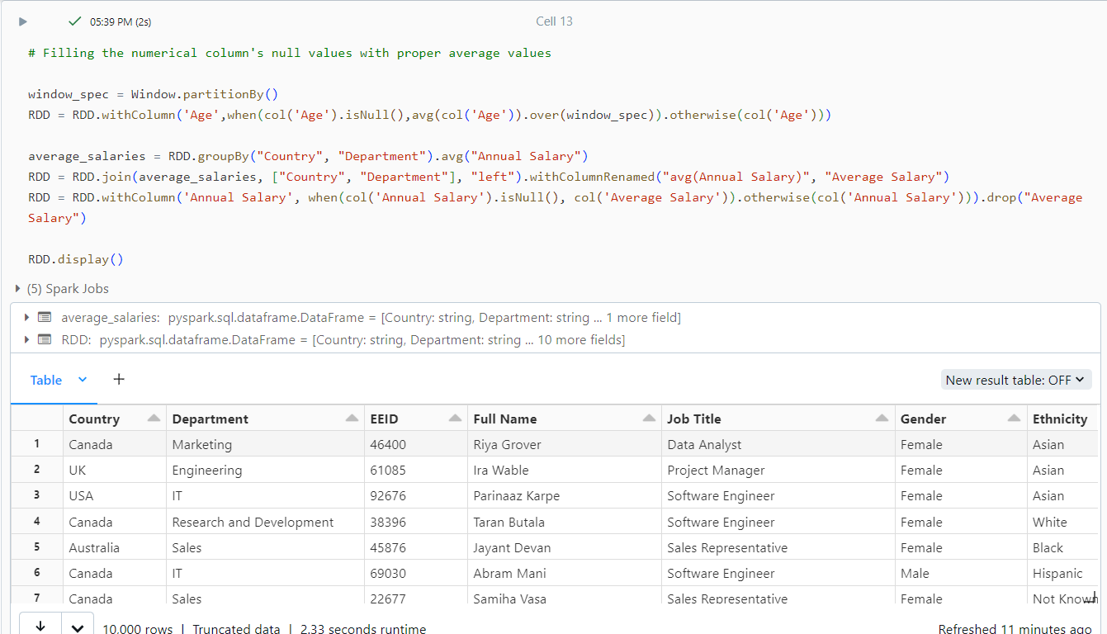
Handling null values of columns with numerical data

Slide 23
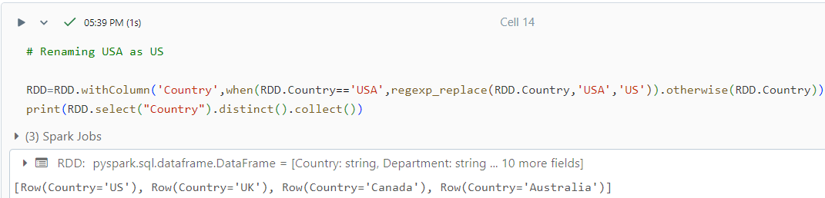
Renaming USA to US to make dataset consistent

Slide 24
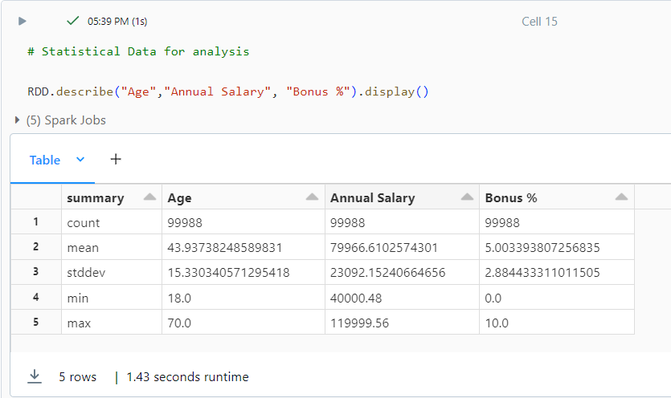
Statistical data

Slide 25
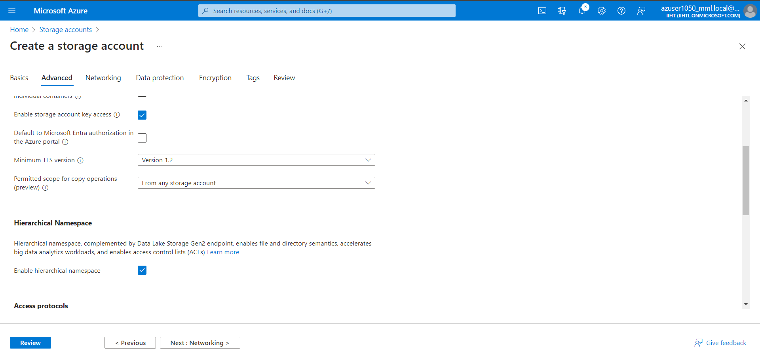
Loading Data into Sink Storage
Create Sink Storage

Slide 26
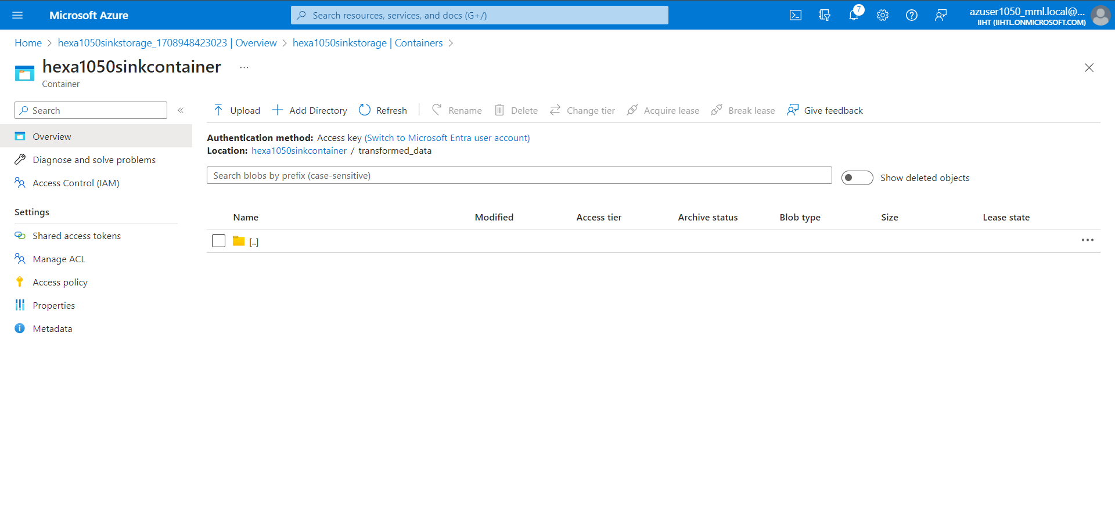
Create empty folder to store the data

Slide 27
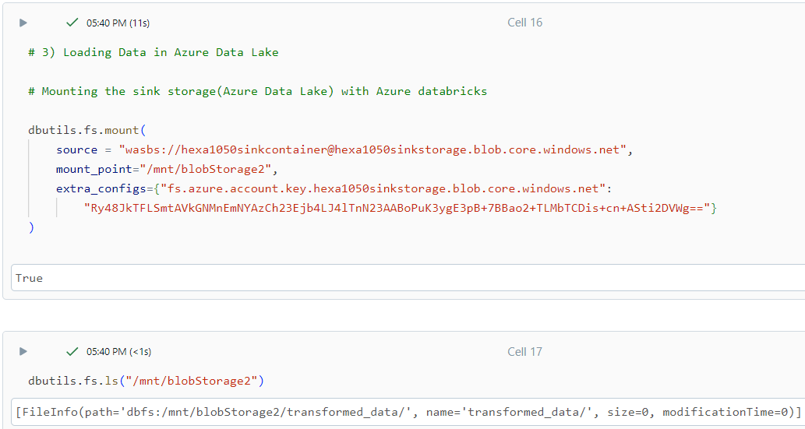
Mounting the storage

Slide 28
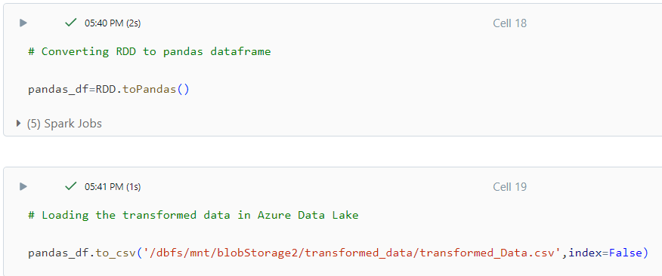
Loading the transformed data

Slide 29
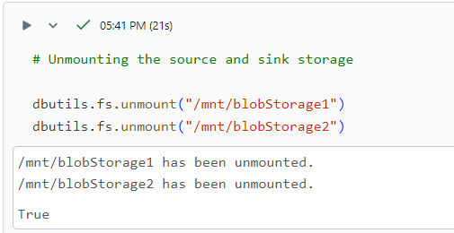
Unmounting the Source and Sink storage

Slide 30
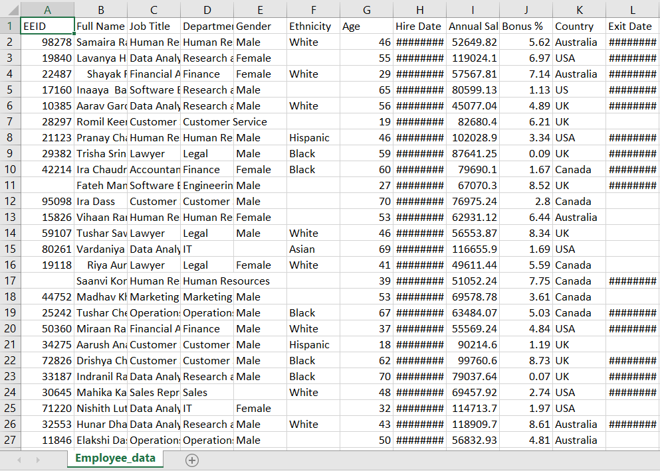
Raw Data

Slide 31
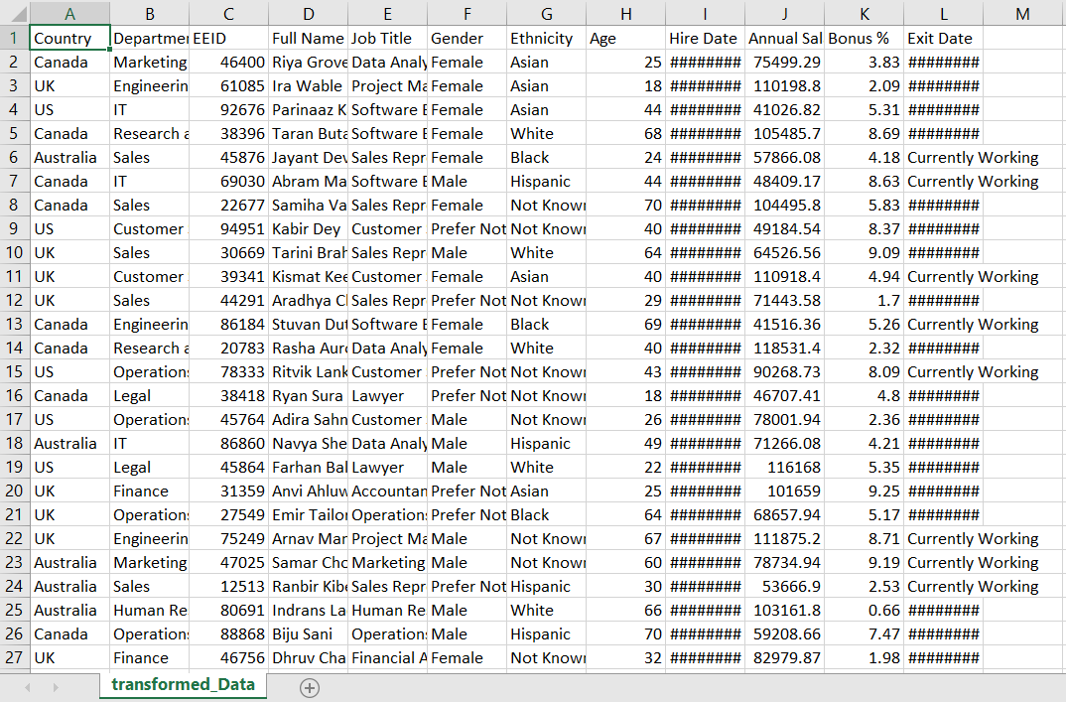
Transformed Data

Slide 32
Conclusion
In conclusion, this project successfully demonstrated the utilization of Azure Databricks and PySpark for large-scale data processing on a sample CSV file containing employee data
Through the implementation of Extract, Transform, Load operations, the dataset was cleaned, transformed, and prepared for further analysis or reporting
Overall, this project serves as a practical demonstration of how Azure Databricks and PySpark can be effectively utilized for large-scale data processing

Slide 33
Thank you

